Slide 1
Course: Digital Logic Design
Lecture No.01
BSAI – 2nd
Instructor: Dr. Tahir Ejaz

Slide 2
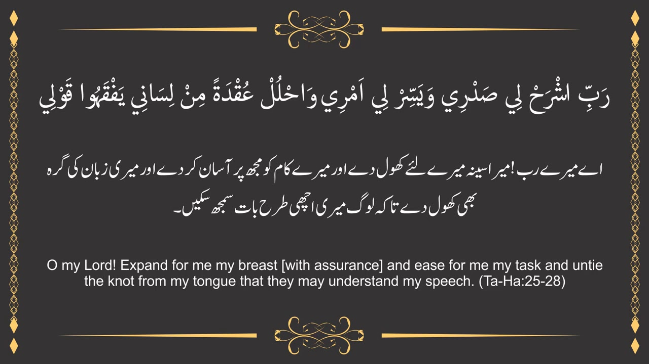

Slide 3
Who I am?
Dr. Tahir Ejaz (Ph. D in Electrical Engineering)
(Associate Professor, IQRA University, Chak Shahzad Campus, Islamabad)
Email: tahir@iqrauni.edu.pk
Previous Employment
Lecturer/Assistant Professor (NUST College of EME)
HoD WTD and R&D (NUST College of EME)
Assistant Professor (HITEC University)
Convenor DQAC (HITEC University)
HoD and Associate Dean (Grafton College)

Slide 4
Course Outlines
Course Name: Digital Logic Design (CMC-123)
Contact Hours: Credit Hours:
Theory: 30 Theory: 2
Practical: 45 Practical: 1
Total: 75 Total: 3
Pre – Requisite: GER-152 Applied Physics

Slide 5
Course Outlines
Course Description
  This course focuses on the principles and practices of Digital Logic Circuit Design and is a first course in this area.
  Topics covered include: Boolean Algebra, Number Systems, Logic Gates, Circuit Implementation of Logic Gates, Speed of Logic Gates and Operating Frequencies, Logic implementation of Boolean expressions, Karnaugh Maps, Analysis and Design of Combinational Logic Circuits, Analysis and Design of Sequential Logic Circuits, Circuits for Arithmetic Calculations, Circuits using memories and Flip-Flops, Registers and Register files, State Machines, Memory Systems, Basic Processor and Control Unit Design

Slide 6
Course Outlines
Course Objectives
  Digital Logic Design is designed to introduce fundamental logic operators and gates, providing the groundwork for understanding the basic building blocks of computers.
  It covers both combinational and sequential circuits, including key components.
  The knowledge gained in this course serves as a stepping stone for advanced studies in Computer Organization and Assembly Language (COAL) and Computer Architecture.
  Students will learn principles of Digital Logic Design.
  They will combine classical design methodologies with a series of laboratory assignments in which they will demonstrate their ability to successfully design, implement, and debug digital systems.

Slide 7
Course Learning Outcomes (CLOs)
Sr. No. | Course Learning Outcomes (CLOs) Statement | Taxonomy Level | GAs
1 | Explain the Digital principles, arithmetic operations, and different simplification techniques required to model any computing system | C2 | 2
2 | Apply Boolean algebra, Karnaugh maps, logic gates, and other techniques to simplify and optimize logic expressions and to design combinational logic circuits to perform specific functional requirements. | C3 | 2
3 | Investigate the functionality and timing characteristics of sequential circuits, including flip-flops, counters, and shift registers, to assess their role in designing reliable digital systems. | C4 | 3

Slide 8
Taxonomy Levels
Cognitive Domain: Involves
  Knowledge, and
  Development of intellectual skills.
Six levels of cognitive processes.
Simplest to most complex.
C1 – Remembering, C2 – Understanding
C3 – Applying, C4 – Analyzing
C5 – Evaluating, C6 - Creating

Slide 9
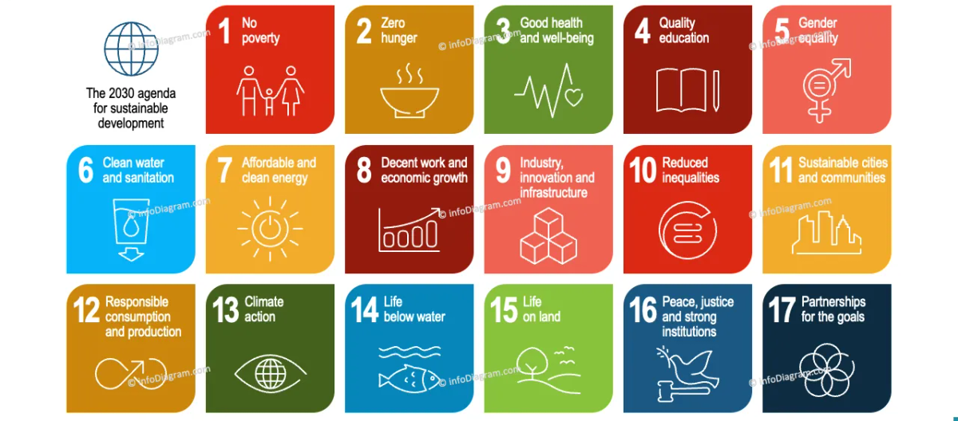
UN Sustainable Developmental Goals

Slide 10
Grading
Letter Grade | Percentage | Grade Points
A | 90% - 100% | 4.00
A- | 85% - 89% | 3.67
B+ | 80% - 84% | 3.33
B | 75% - 79% | 3.00
B- | 70% - 74% | 2.67
C+ | 65% - 69% | 2.33
C | 60% - 64% | 2.00
C- | 56% - 59% | 1.67
D+ | 53% - 55% | 1.33
D | 50% - 52% | 1.00
F | Below 50% | 0

Slide 11
Course Outlines
Assessment Instruments with Weights
  Assignments, Quizzes, Midterms, Final,Lab Work, etc.)
  Theory
    Quizzes 10
    Assignment 15
    Midterm 25
    Presentation/Other Activities 10
    Final 40

Slide 12
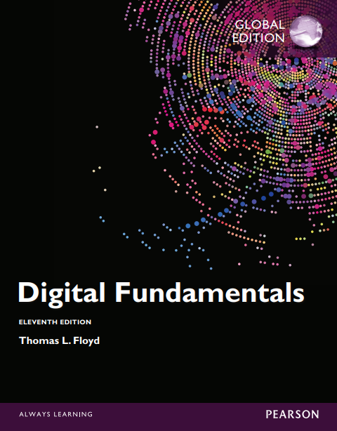
Course Outlines
Text & Reference Books
  “Digital Fundamentals” by Thomas L. Floyd, 11th Edition (Pearson)

Slide 13
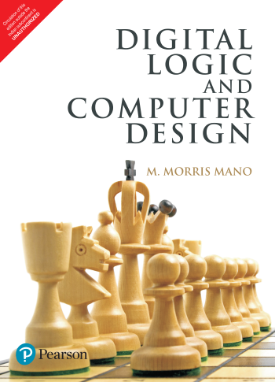
Course Outlines
Text & Reference Books
  “Digital Logic and Computer Design” by M. Morris Mano, 4th Edition, 2016, (Pearson)

Slide 14
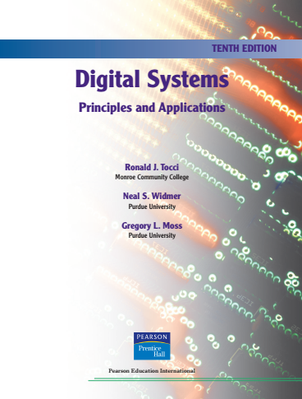
Course Outlines
Text & Reference Books
  “Digital Systems (Principles and Applications)”by Ronald J. Tocci, Neal S. Widmer & Gregory L. Moss, 10th Edition

Slide 15
Lecture Contents
Course introduction and DLD basics
  Introduction to Digital Logic Design
  Information Representation
  Analog Systems vs Digital Systems
  Digital Systems Representations
  Number Systems

Slide 16
Introduction to Digital Logic Design

Slide 17
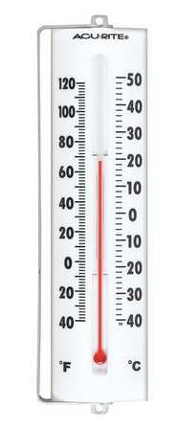
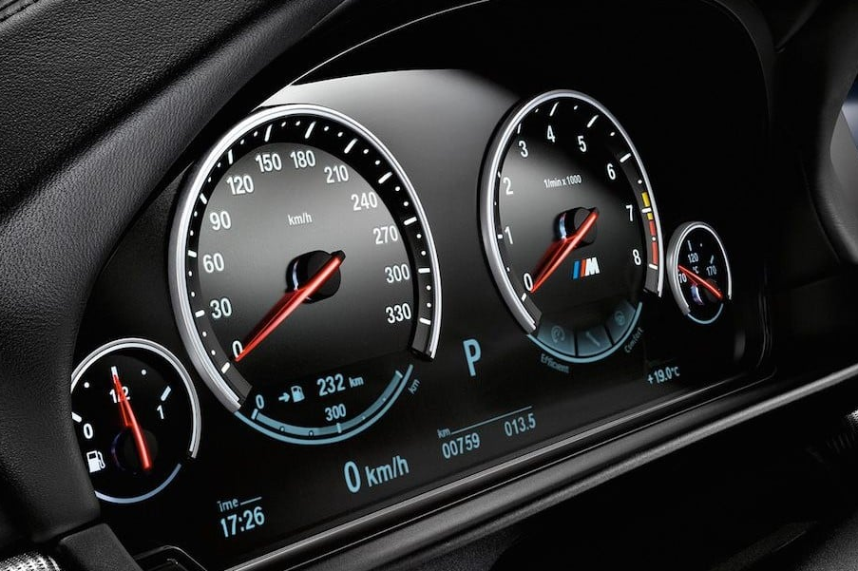
Introduction to Digital Logic Design
Analog & Digital Representation
  In analog representation a quantity is represented by a continuously variable.
    Automobile speedometer
    Analog thermometer

Slide 18
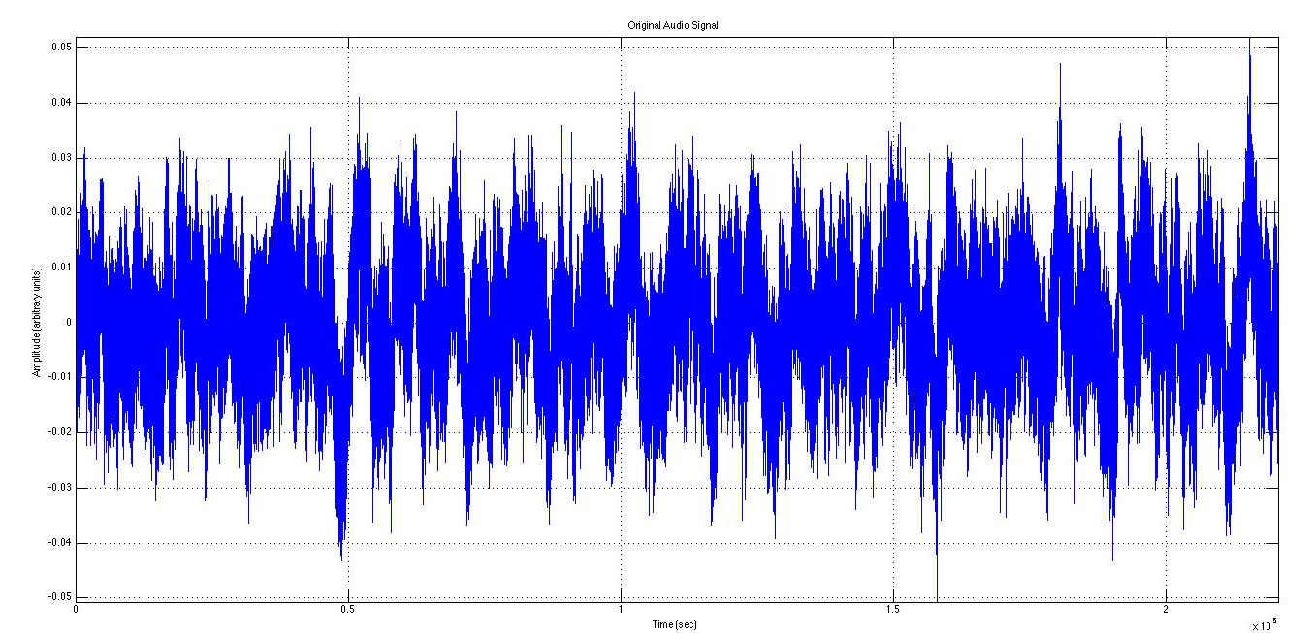
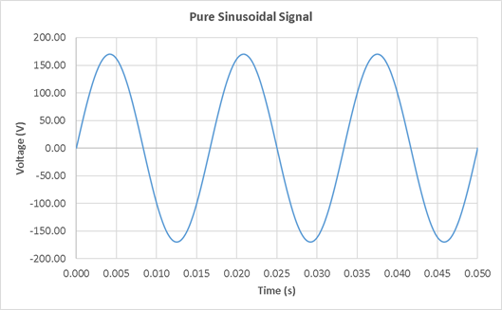
Introduction to Digital Logic Design
Analog & Digital Representation
  In analog representation a quantity is represented by a continuously variable.
    Electrical Signals
      Voltage & Current
    Sound

Slide 19
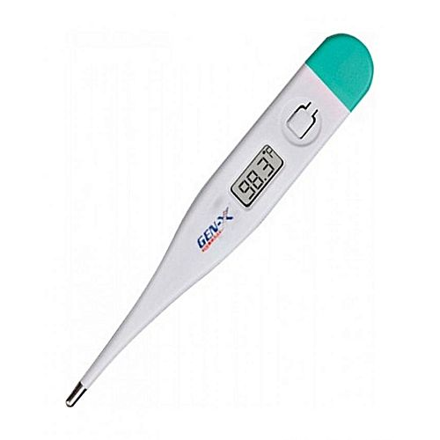
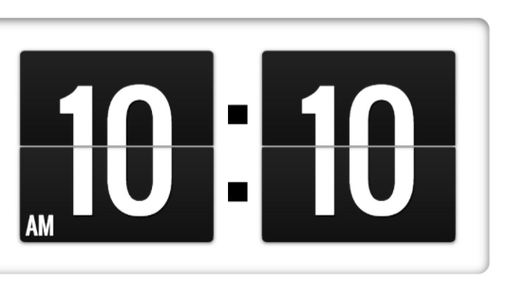
Introduction to Digital Logic Design
Analog & Digital Representation
  In digital representation the quantities are represented not by continuously variable indicators but by symbols called digits.
    Digital Clock
    Digital Thermometer
19

Slide 20
Introduction to Digital Logic Design
Analog vs Digital
  The major difference between analog and digital quantities, then, can be simply stated as follows:
    Analog = Continuous
    Digital = Discrete (step by step).

Slide 21
Introduction to Digital Logic Design
Analog Systems
  An analog system contains devices that manipulate physical quantities that are represented in analog form.
  In an analog system, the quantities can vary over a continuous range of values.
  Examples:
    The amplitude of the output signal to the speaker.
    Audio amplifiers.
    Magnetic tape recording and playback equipment, and a simple light dimmer switch.

Slide 22
Introduction to Digital Logic Design
Digital Systems
  A digital system is a combination of devices designed to manipulate logical information or physical quantities that are represented in digital form that is, the quantities can take on only discrete values.
  These devices are most often electronic, but they can also be mechanical, magnetic, or pneumatic.

Slide 23
Introduction to Digital Logic Design
Digital Systems
  Some of the more familiar digital systems include digital computers and calculators, digital audio and video equipment, and the telephone system—the world’s largest digital system.
  Digital Systems have such a prominent role in everyday life that we refer to the present technological period as the Digital Age.

Slide 24
Introduction to Digital Logic Design
Digital Systems Daily Life Examples
  Digital systems are used in Communication, Business Transactions, Traffic Control, Spacecraft Guidance, Medical Treatment, Weather Monitoring, the Internet, and many other Commercial, Industrial, and Scientific Enterprises.
  We have Digital Telephones, Digital Televisions, Digital Versatile Discs, Digital Cameras, Handheld Devices, and, of course, Digital Computers.

Slide 25
Introduction to Digital Logic Design
Characteristics of Digital Systems
  One characteristic of Digital Systems is their ability to Represent and Manipulate discrete elements of information.
  Any set that is restricted to a finite number of elements contains discrete information.
  Examples of Discrete Sets are the 10 Decimal Digits, the 26 Letters of the Alphabet, the 52 playing Cards, and the 64 Squares of a Chessboard.
  Earlier Digital Computers were used for numeric computations.
  In this case, the discrete elements were the digits.
  From this application, the term Digital Computer emerged.

Slide 26
Introduction to Digital Logic Design
Representation to Discrete Elements
  Discrete Elements of information are represented in a Digital System by physical quantities called Signals.
  Electrical Signals such as voltages and currents are the most common. Electronic devices called transistors predominate in the circuitry that implements these signals.
  The signals in most present‐day electronic digital systems use just two discrete values and are therefore said to be Binary.

Slide 27
Introduction to Digital Logic Design
Representation to Discrete Elements
  A binary digit, called a bit, has two values: 0 and 1.
  Discrete elements of information are represented with groups of bits called binary codes.
  For example, the decimal digits 0 through 9 are represented in a digital system with a code of four bits (e.g., the number 7 is represented by 0111).

Slide 28
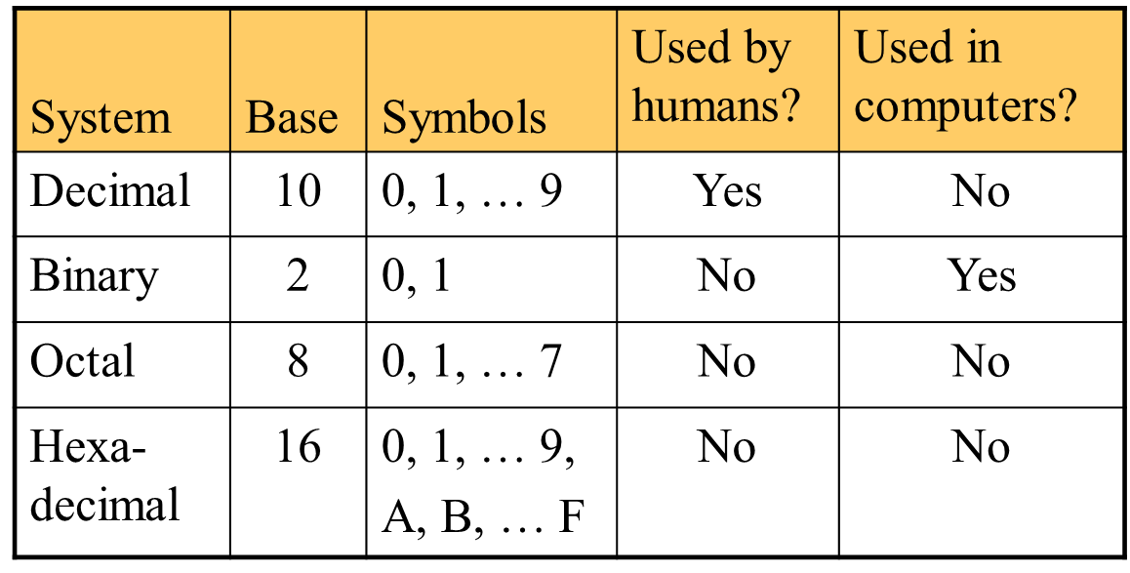
Introduction to Number Systems
Representation Number Systems

Slide 29
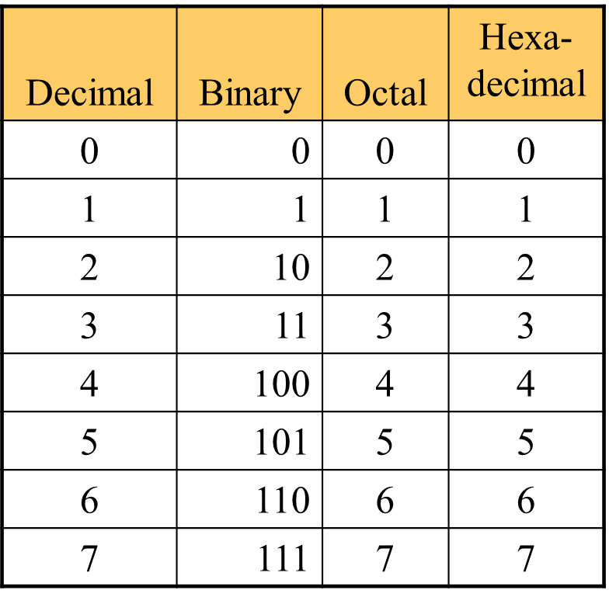
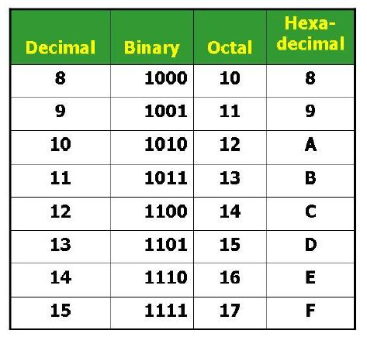
Introduction to Number Systems

Slide 30
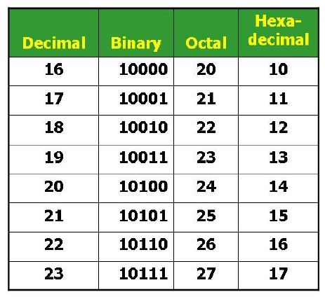
Introduction to Number Systems

Slide 31
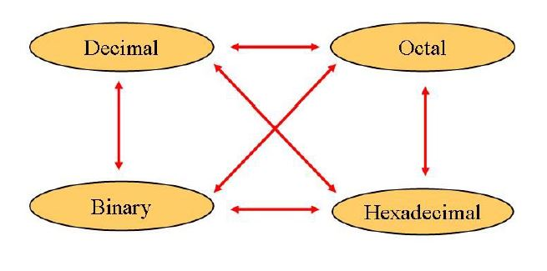
Number Systems - Conversion
The Possibilities

Slide 32
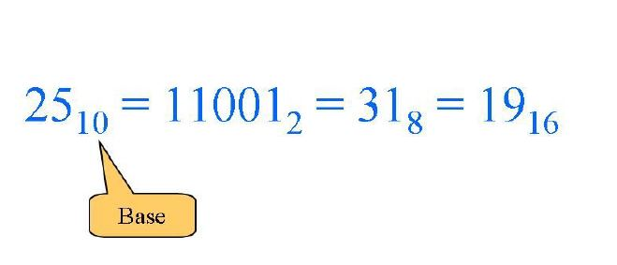
Number Systems - Conversion
Representation

Slide 33
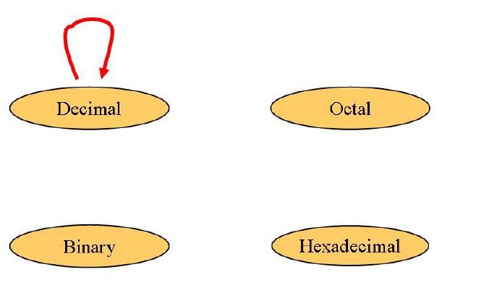
Number Systems - Conversion
Decimal to Decimal (Just for Fun)

Slide 34
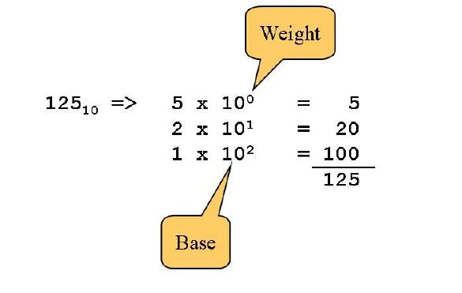
Number Systems - Conversion
Decimal to Decimal (Just for Fun)

Slide 35
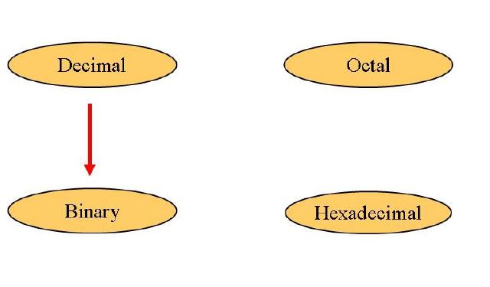
Number Systems - Conversion
Decimal to Binary

Slide 36
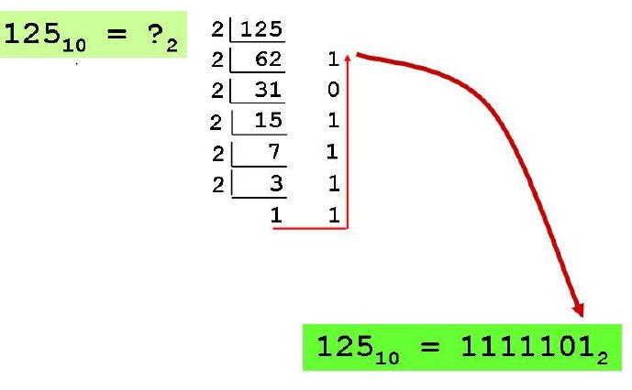
Number Systems - Conversion
Decimal to Binary
  Repeated Division Method:
    Divide by 2, keep track of remainder
    First remainder is bit “0” (LSB, Least Significant Bit)
    Second remainder is bit 1
    etc.

Slide 37
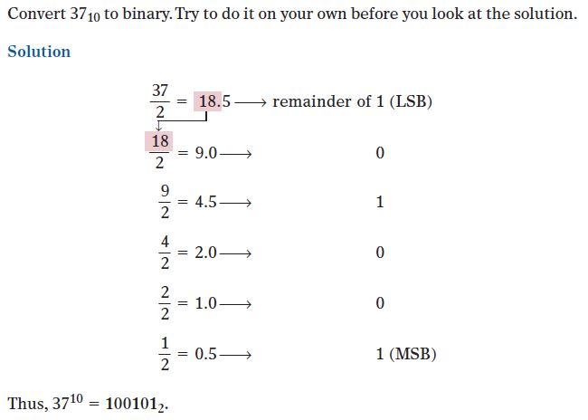
Number Systems - Conversion
Decimal to Binary (Example)

Slide 38
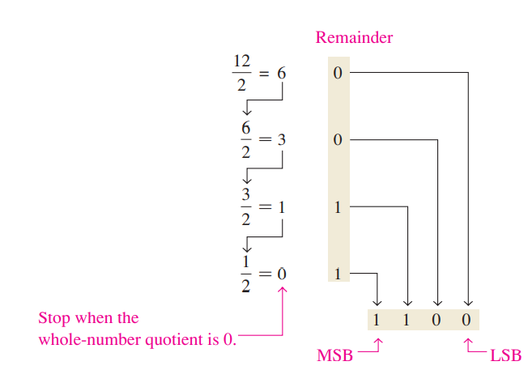
Number Systems - Conversion
Decimal to Binary (Example)

Slide 39
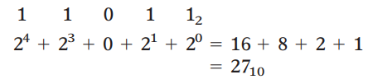


Number Systems - Conversion
Decimal to Binary
  Sum of Weights Method

Slide 40
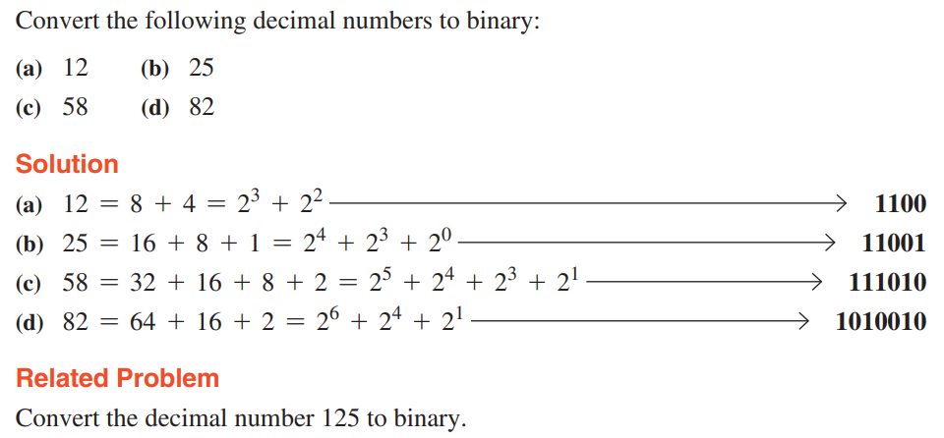
Number Systems - Conversion
Decimal to Binary (Examples)
  Sum of Weights Method

Slide 41
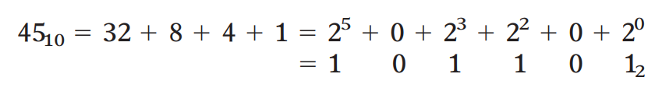

Number Systems - Conversion
Decimal to Binary (Examples)
  Sum of Weights Method

Slide 42
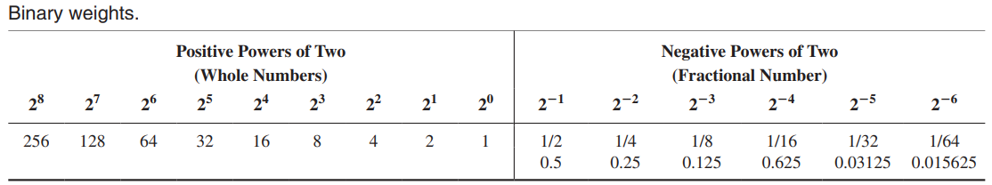
Number Systems - Conversion
Decimal to Binary

Slide 43
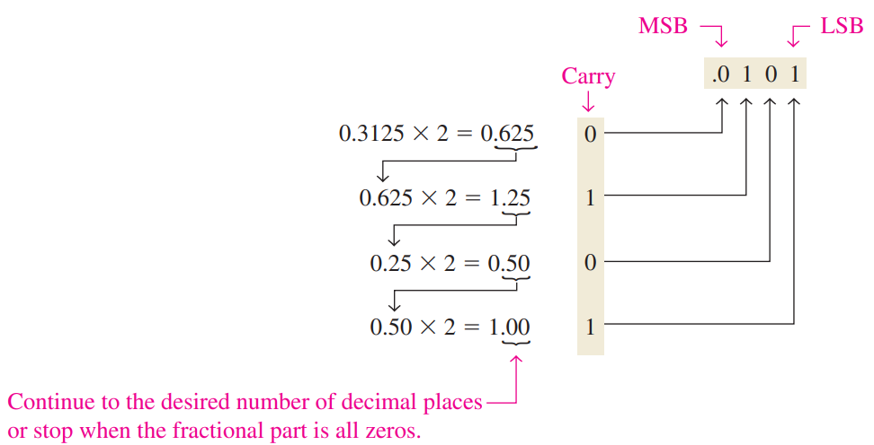
Number Systems - Conversion
Decimal Fraction to Binary (Example)

Slide 44
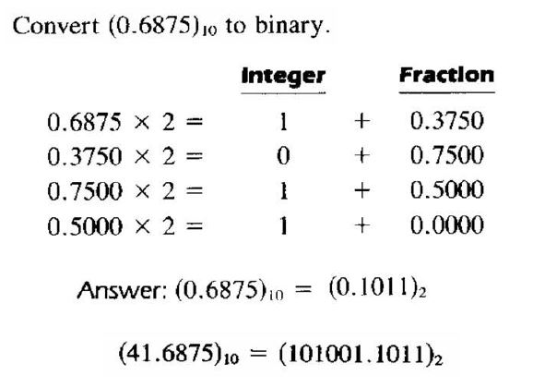
Number Systems - Conversion
Decimal to Binary (Example)

Slide 45
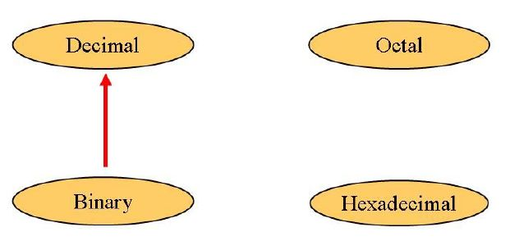
Number Systems - Conversion
Binary to Decimal

Slide 46
Number Systems - Conversion
Binary to Decimal
Technique:
  Multiply by 2^{n}, where “n” is the weight of the bit
  The weight is the position of the bit, starting from “0” on the right
  Add the result

Slide 47
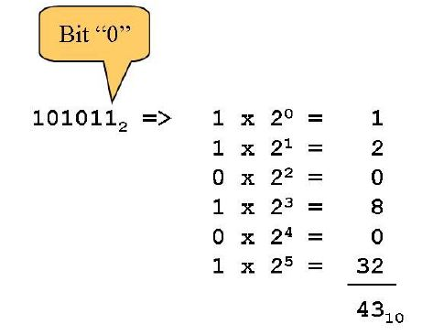
Number Systems - Conversion
Binary to Decimal

Slide 48
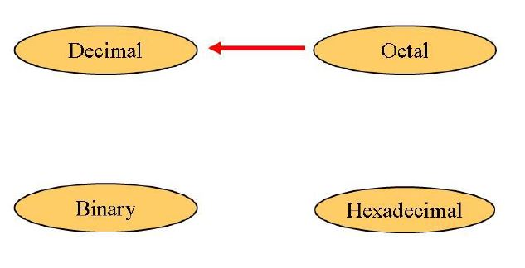
Number Systems - Conversion
Octal to Decimal

Slide 49
Number System Conversion
Octal to Decimal:
Technique:
  Multiply each bit by 8^{n}, where “n” is the weight of the bit
  The weight is the position of the bit, starting from “0” on the right
  Add the result

Slide 50
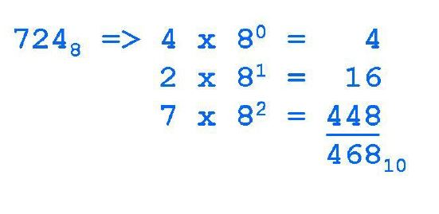
Number System Conversion
Octal to Decimal:

Slide 51
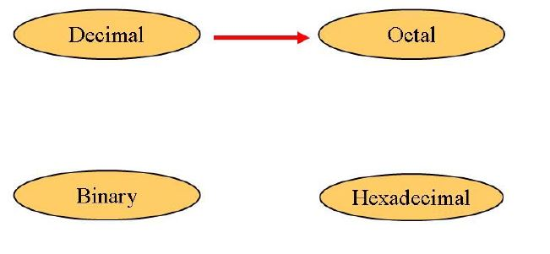
Number System Conversion
Decimal to Octal:

Slide 52
Number System Conversion
Decimal to Octal:
Technique:
  Divide by 8
  Keep track of remainder

Slide 53
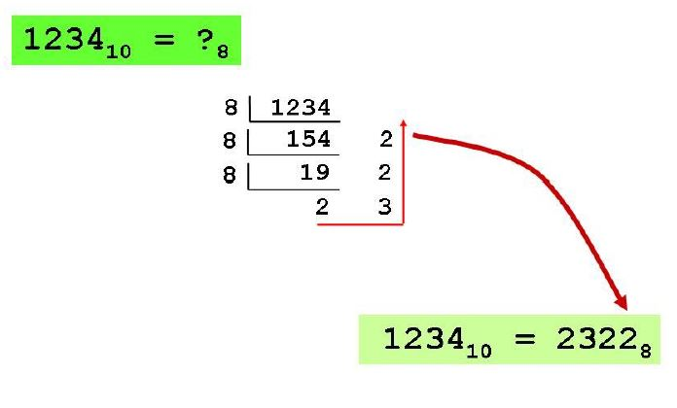
Number System Conversion
Decimal to Octal:

Slide 54
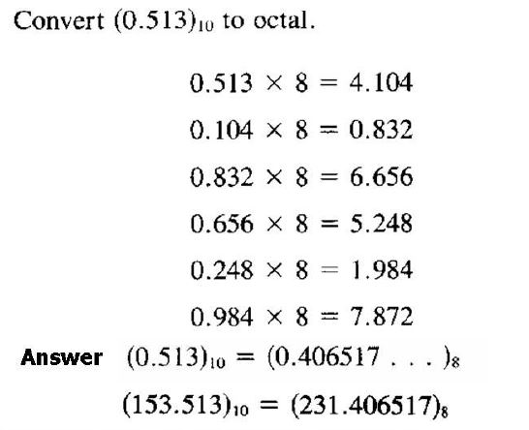
Number System Conversion
Decimal to Octal:

Slide 55
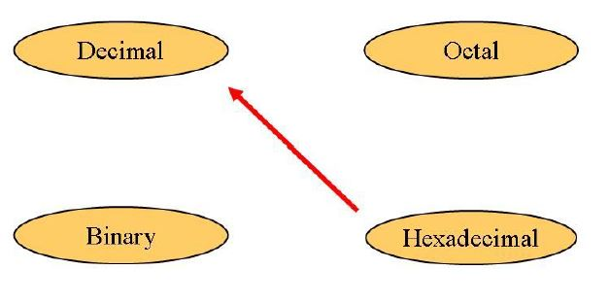
Number System Conversion
Hexadecimal to Decimal:

Slide 56
Number System Conversion
Hexadecimal to Decimal:
Technique:
  Multiply each bit by 16^{n}, where “n” is the weight of the bit
  The weight is the position of the bit, starting from “0” on the right
  Add the result

Slide 57
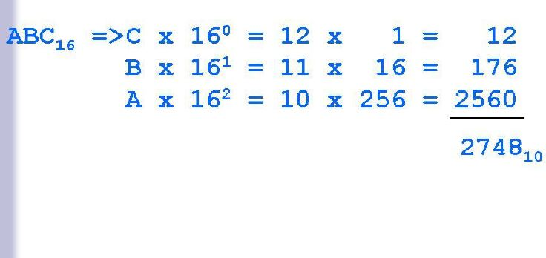
Number System Conversion
Hexadecimal to Decimal:

Slide 58
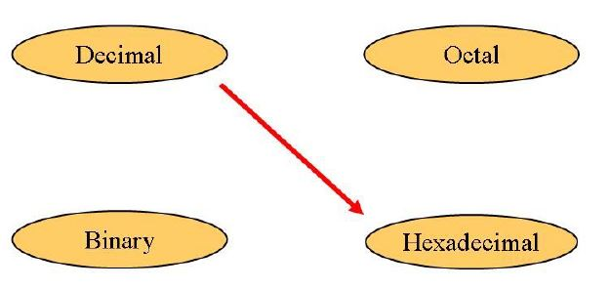
Number System Conversion
Decimal to Hexadecimal:

Slide 59
Number System Conversion
Decimal to Hexadecimal:
Technique:
  Divide by 16
  Keep track of remainder

Slide 60
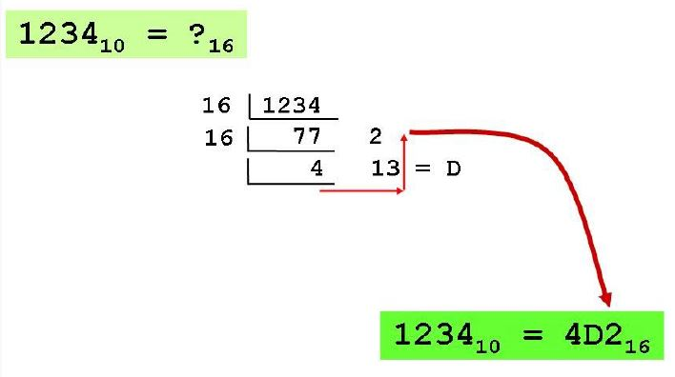
Number System Conversion
Decimal to Hexadecimal:

Slide 61
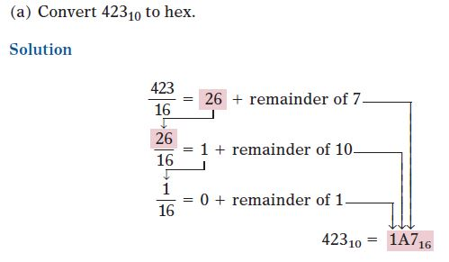
Number System Conversion
Decimal to Hexadecimal: (Example)

Slide 62
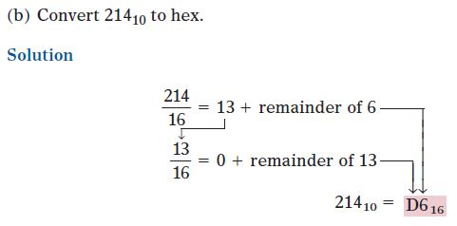
Number System Conversion
Decimal to Hexadecimal: (Example)

Slide 63
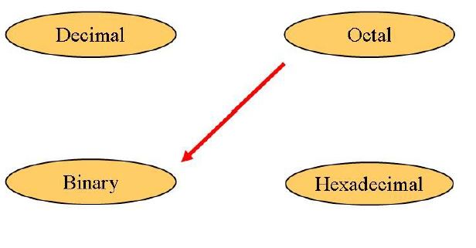
Number System Conversion
Octal to Binary:

Slide 64
Number System Conversion
Octal to Binary:
Technique:
  Convert each octal digit to 3-bit equivalent binary representation.

Slide 65
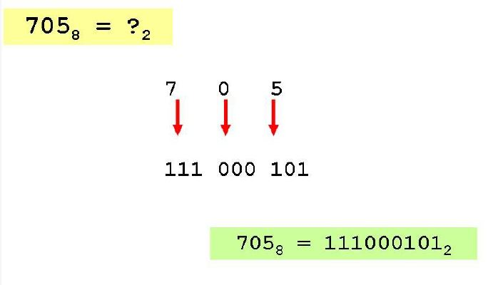
Number System Conversion
Octal to Binary:

Slide 66
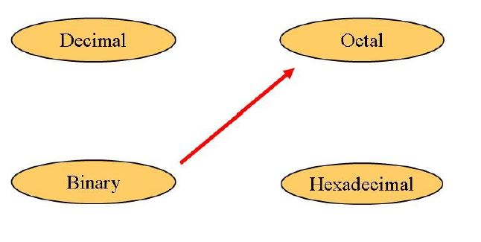
Number System Conversion
Binary to Octal:

Slide 67
Number System Conversion
Binary to Octal:
Technique:
  Group bits in threes, starting on right
  Convert to Octal Digits

Slide 68
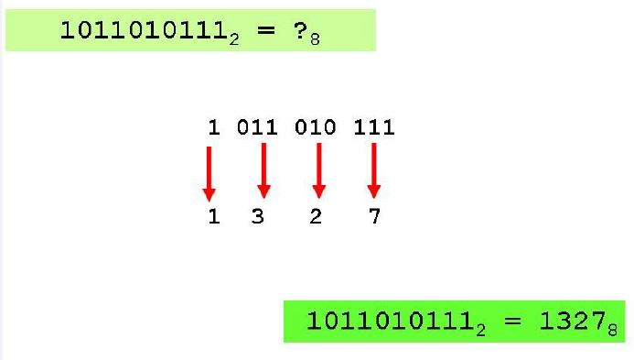
Number System Conversion
Binary to Octal:

Slide 69
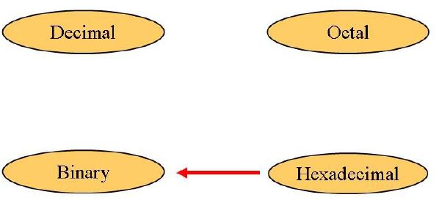
Number System Conversion
Hexadecimal to Binary:

Slide 70
Number System Conversion
Hexadecimal to Binary:
Technique:
  Convert each Hexadecimal digit to 4-bit equivalent binary representation.

Slide 71
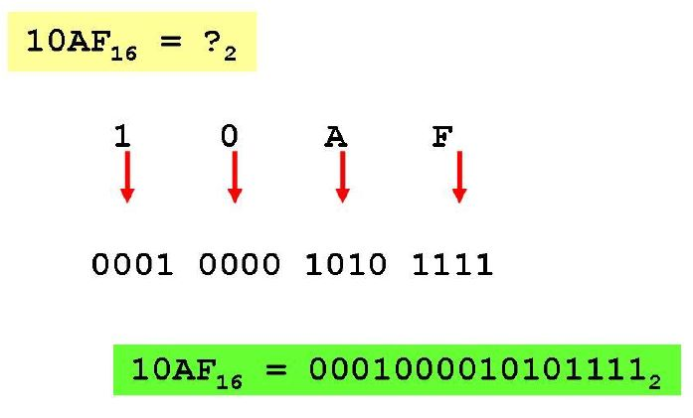
Number System Conversion
Hexadecimal to Binary:

Slide 72
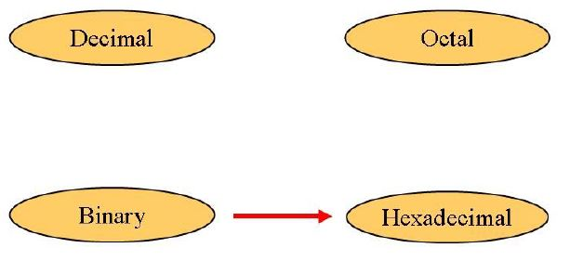
Number System Conversion
Binary to Hexadecimal:

Slide 73
Number System Conversion
Binary to Hexadecimal:
Technique:
  Group bits in fours, starting on right
  Convert to Hexadecimal Digits

Slide 74
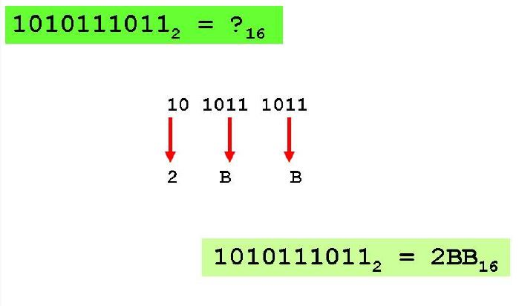
Number System Conversion
Binary to Hexadecimal:

Slide 75

Number System Conversion
Octal to Hexadecimal:

Slide 76
Number System Conversion
Octal to Hexadecimal:
Technique:
  Use binary as intermediary

Slide 77

Number System Conversion
Octal to Hexadecimal:

Slide 78

Number System Conversion
Hexadecimal to Octal:

Slide 79
Number System Conversion
Hexadecimal to Octal:
Technique:
  Use binary as intermediary

Slide 80

Number System Conversion
Hexadecimal to Octal:

Slide 81

Number System Conversion
Exercise:

Slide 82

Number System Conversion
Exercise: (Answer)

Slide 83

Common Powers
Common Powers:
  Base 10

Slide 84

Number System Conversion
Common Powers:
  Base 2

Slide 85
Lecture Summary
Introduction to Digital Logic Design
What are Digital Systems
Analog vs Digital Systems
Characteristics Of Digital Systems
Representation of Discrete Elements
Number system

Slide 86
Useful Videos
https://www.youtube.com/watch?v=ZWdT-6Ld71Q
https://www.youtube.com/watch?v=ZWdT-6Ld71Q
https://www.youtube.com/watch?v=-f6fjBhu8eA

Slide 87

WhatsApp Group
Every student must join the WhatsApp group pertaining to this course

Slide 88
Thank You !

